Slide 1

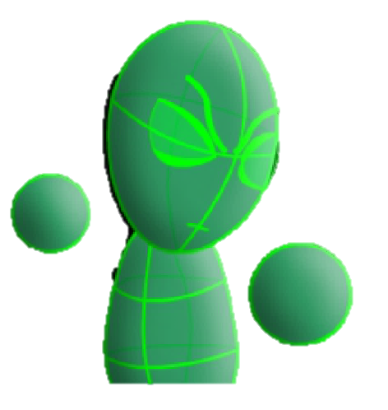

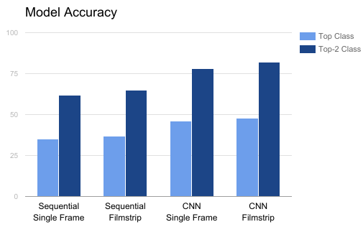
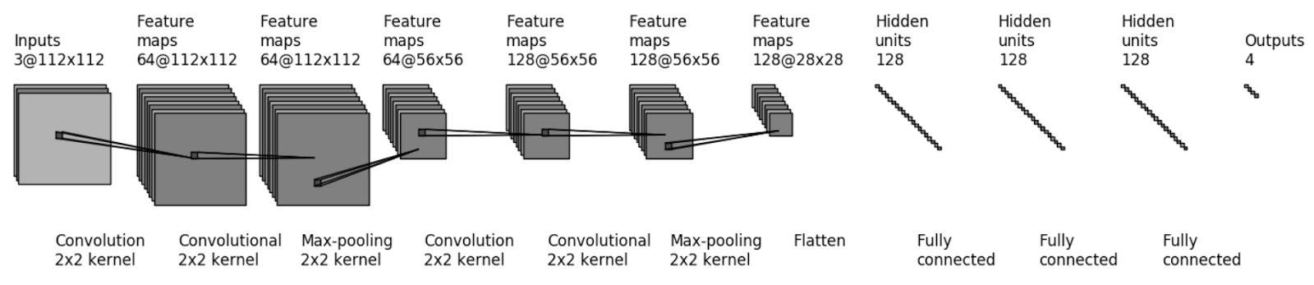
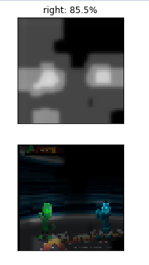
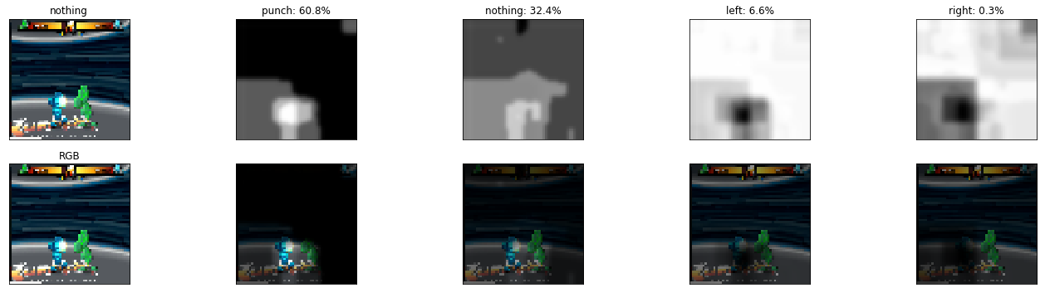
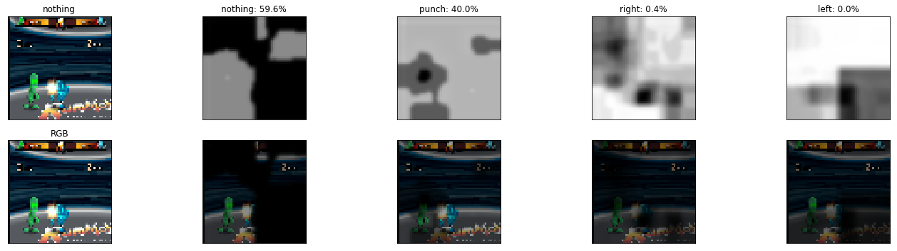
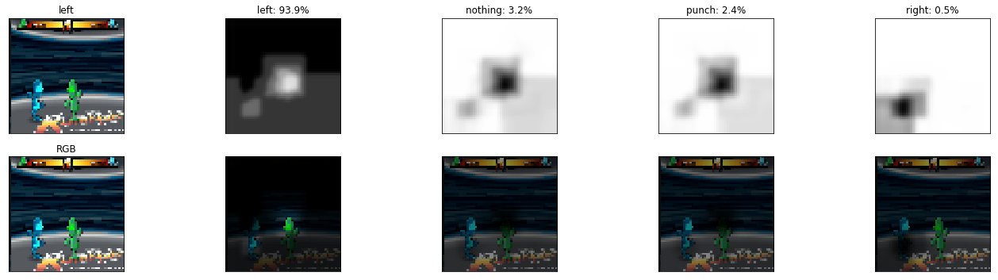
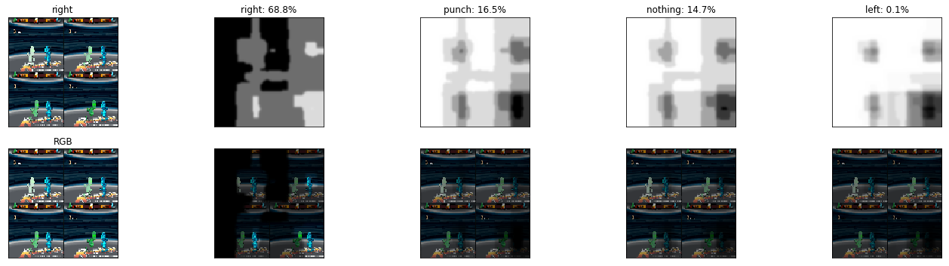
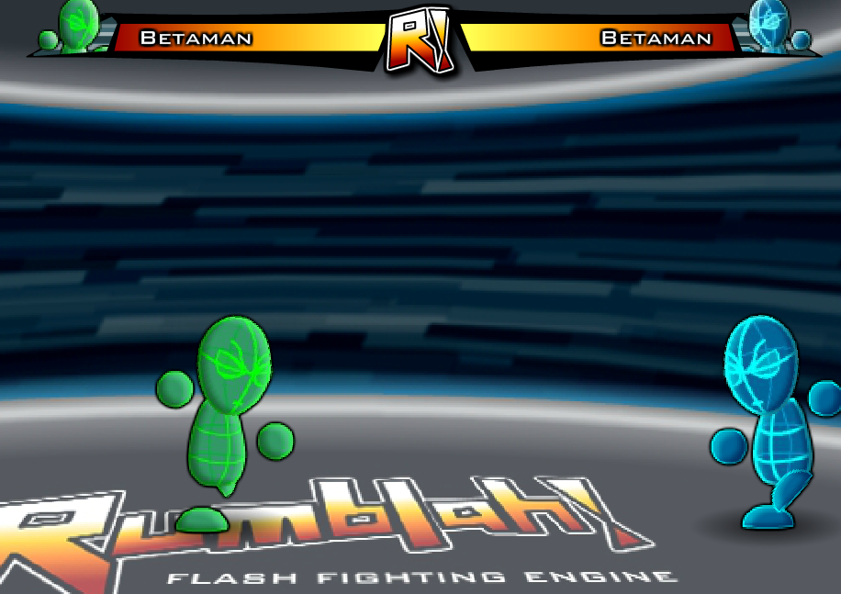
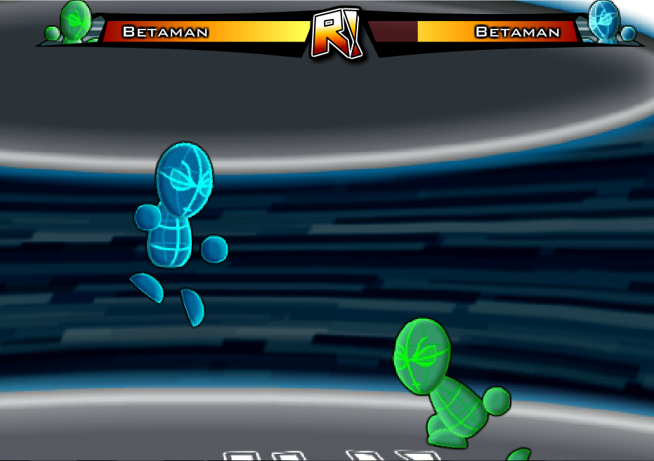
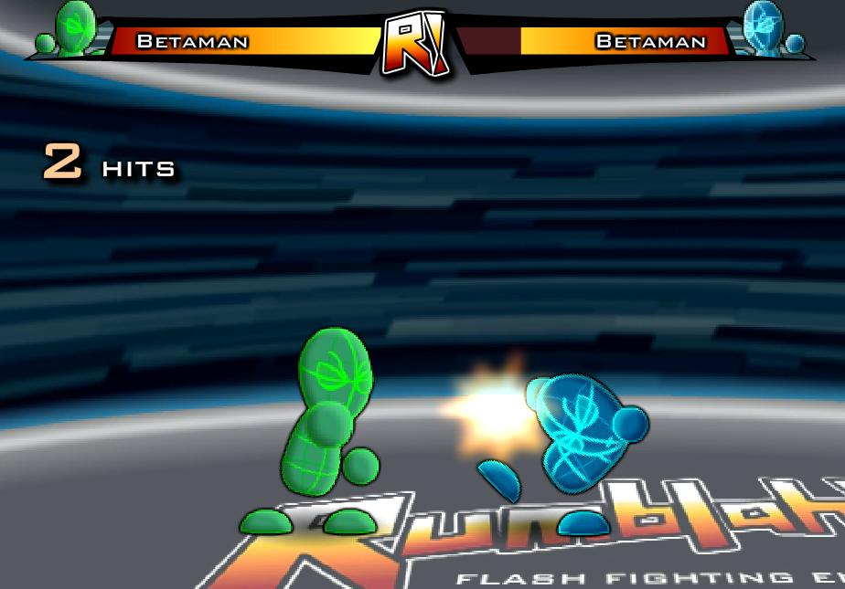
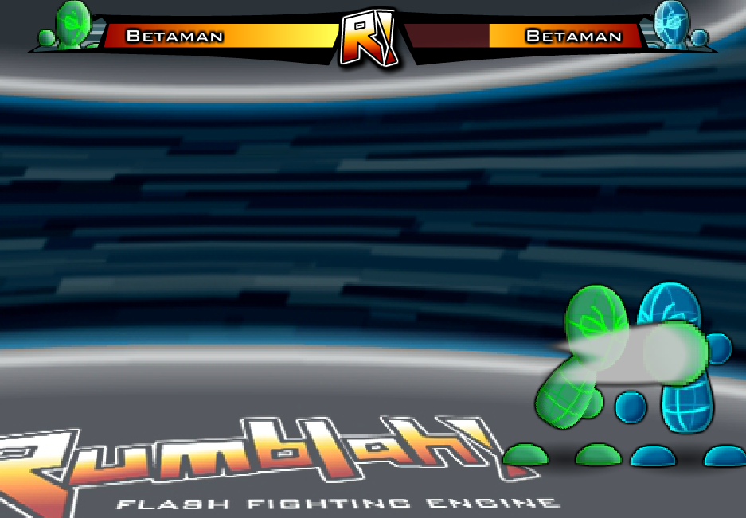
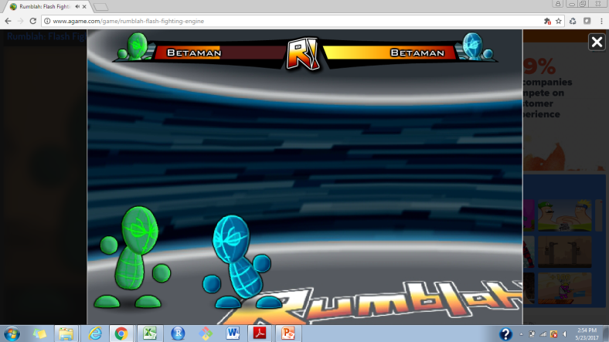





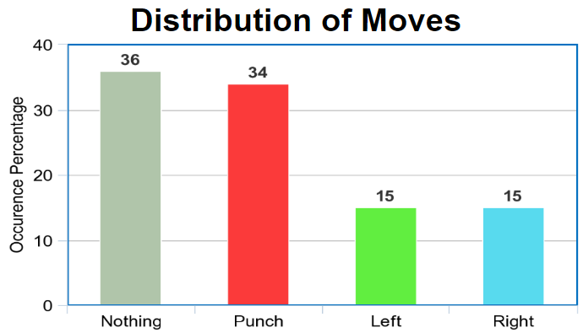
Learning to Fight
Michael Cho, Annie Didier, Dustin Fontaine, Dylan Fontaine | MSiA 490-30 Deep Learning | Spring 2017 | Northwestern University
Problem Statement
Technical Approach
Results
Artificial intelligence (AI) is used in video games to control non-human “computer” players. The AI often relies on simple logic and heuristics instead of more complex models that allow the computer to closely imitate human behavior.
Games that feature a human-trained AI could be very popular among both recreational and hardcore gamers. “Play GTA VI cooperatively with AI trained by celebrity Snoop Dogg” or “Fight against AI trained by World Champion Mew2King” are possible headlines that could be used to market such games.
While reinforcement learning is commonly used to create video game AI, that approach is very time consuming and does not necessarily lead to a human-like play style. We will use the image classification framework proposed by Chen and Yi of Stanford (2016) to create an AI for the game “Rumblah: Flash Fighting Engine”.
Fitting Models
The initial model that we fit to our data was a simple feedforward neural network. This model was created to serve as a proof-of-concept and baseline that future models could be compared to.
The next model that we fit was a convolutional neural network. Convolutional models are known to perform well with image recognition problems, so this type of model was the natural next step for us. We based our model’s architecture on the popular VGG16 model.
Since the first two models we fit only consider a single screenshot and not any previous information, we decided to fit sequential and convolutional models using “filmstrips” of four consecutive screenshots stitched together. The goal is to allow the models to consider not only the current state of the fight, but also the state just prior to current moment.
Playing the Game
To put our models into action, we developed a program that controls one of the players (the green player) in the game. It can fight against a CPU or human opponent.
A pipeline was created that was similar in function to the image preprocessing in the model fitting stage. As the game is running in the browser, screenshots are captured and downscaled, then fed into the model. The model outputs a predicted class for the current screenshot and emulates the associated keystroke in the browser, thus controlling the green character.
During initial trial runs of gameplay, our AI would get stuck and not perform any actions. This was due to many screenshots being classified as “Do Nothing”. Since human players rarely decide to “Do Nothing” (they only really do nothing in between subsequent button presses), we decided to deter the AI from doing nothing by downscaling the predicted probability for that class. Thus, the AI became more active and avoided getting stuck in ruts of inaction.
As we expected, the CNN film-strip model performed the best, followed by the convolutional model and then the feed-forward model. Even though an accuracy near 50% may seem low, this is close to the human accuracy level
of 56% (based on a random sample of 100 screenshots).
An interesting finding we had is that the models generally focus on the same things that humans do when playing the game. The pixels that turned out to be the most important when classifying a new image usually corresponded to the location of the two players and occasionally the combo-meter. See the example heatmaps below.
Dataset
Right
Punch
Do Nothing
Left
We generated our dataset by recording human vs. human matches on “Rumblah: Flash Fighting Engine”. As two players fought each other, we captured screenshots of the gameplay and logged the keystrokes of one of the players. The game settings were held constant throughout recording and we always logged the keystrokes of the green player. The resulting screenshots were labelled according to which key (if any) the player was pressing while the screenshot was taken. See the example screenshots below:
Collecting screenshots in this manner allowed us to capture the actions that a human made based on stimuli present on the screen. In other words, the human reacted to various things on the screen such as the position of the opponent and then decided which button to press. Our dataset captures this information.
The top row shows actual screenshots and the bottom row shows the corresponding heatmaps.
Right
An aspect of the AI’s performance that is difficult to measure is how human-like it plays the game. Based on our observation, the AI plays similar to how humans play, with the general strategy of moving towards the opponent if they are out of attack range, and repeatedly punching the opponent if they are within attack range. However, the AI appears to play more predictably than a human. We believe that adding stochasticity to the AI’s decision making could solve this issue.
Conclusion
From left to right, these screenshots were labelled “Right”, “Left”, “Punch”, and “Do Nothing”.
Punch
Punch
Raw Screenshot
Downscaled 56x56
Classified by Model
Keystroke Emulated
The results have demonstrated the viability of this image classification framework for creating a video game AI. While Rumblah is a relatively simple game, this framework is general enough to be applied to any action game. With a moderately sized sample of recorded gameplay, an image classification model can be fit and used to control an AI. Compared to reinforcement learning, this approach is less computationally expensive and can get by with less training data. A drawback is that this model bases the AI purely on the behavior of the human player it is trained on and instead of learning the optimal strategy itself. This, however, can allow it to take on human like characteristics, which may be of interest to video game developers.
To improve this work, more sophisticated methods like incorporating the time series of actions that lead up to the current screenshot could be used. Instead of stitching the previous images together, the classifications of the last few observations could be used as predictors for the image at hand. In addition, it would be interesting to apply this methodology to a variety of other video games to further understand its’ strengths and weaknesses.
Games | 50
Screenshot Count | 25,000 (20,000 train)
Original Size | 976px x 650px
Downscaled | 56px x 56px
Frequency | ~10 per second
Format | RGB
Player | Dustin
References and Related Work
http://cs231n.stanford.edu/reports/2016/pdfs/113_Report.pdf

